Slide 1
MINI PROJECT
DIGITAL ACCESS CONTROLLER

Slide 2
WHAT IS A DIGITAL ACCESS CONTROLLER?
A digital access controller is a device which uses certain pattern in order to unlock and give access to important documents that a particular person or an organization wants to keep secure from unauthorized personnel.

Slide 3
GIVEN SPECIFICATIONS
Controller works in two modes:
Day mode: Door opens when op=”1111” or when correct code is entered.
Night mode: Door opens only if code is correct.
The controller sets an “alarm signal” as soon as one of the entered no. is not correct.
The controller returns to idle state if alarm rings for 5 seconds. It uses reset to return to idle state.
Correct code:- 53A17

Slide 4
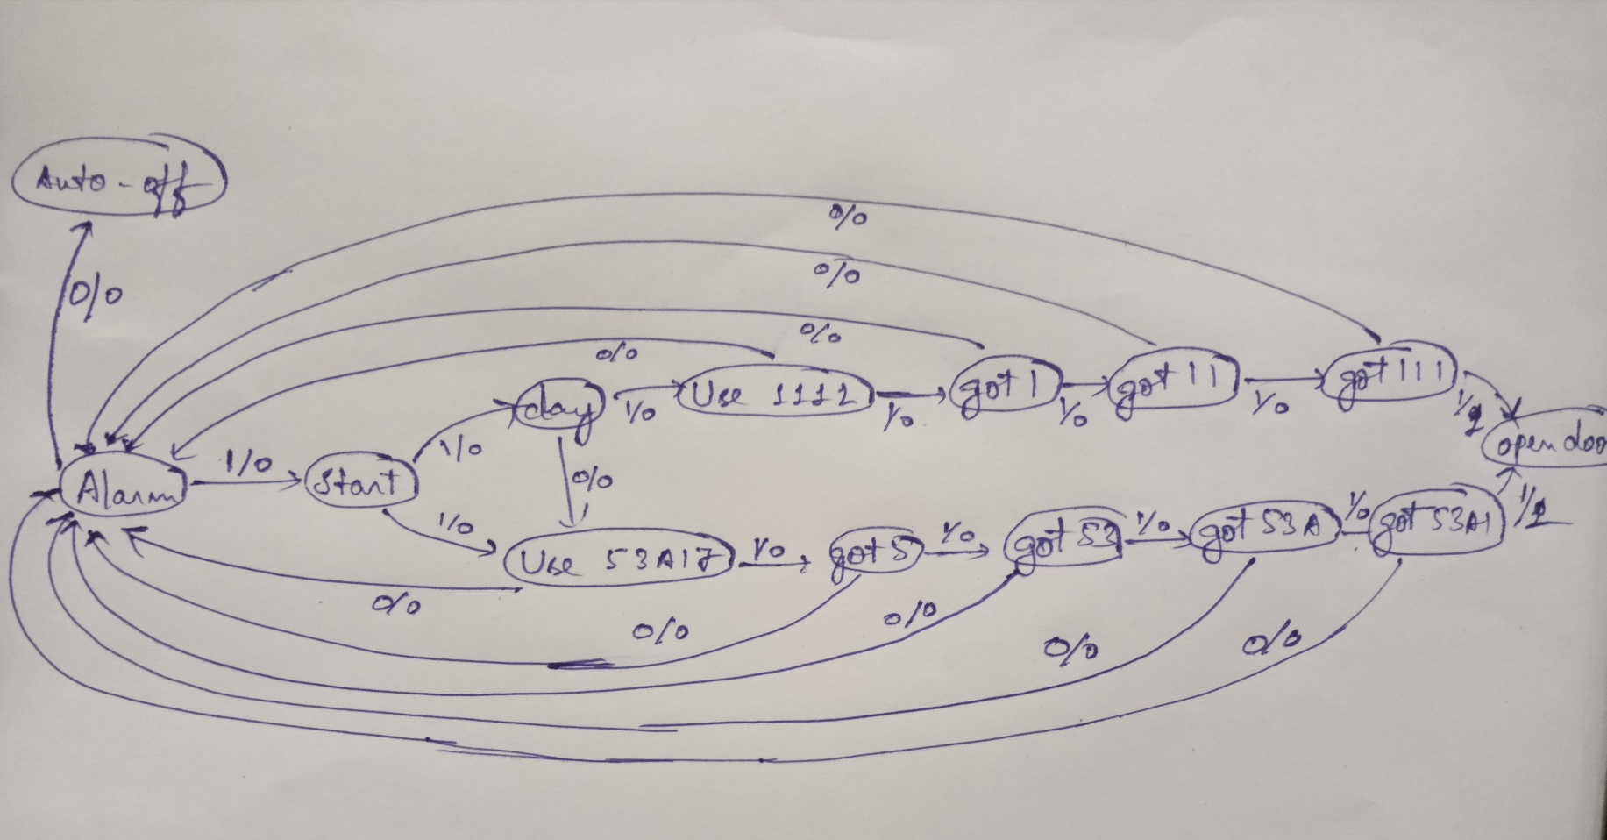
FINITE STATE MACHINE OF DAC

Slide 5
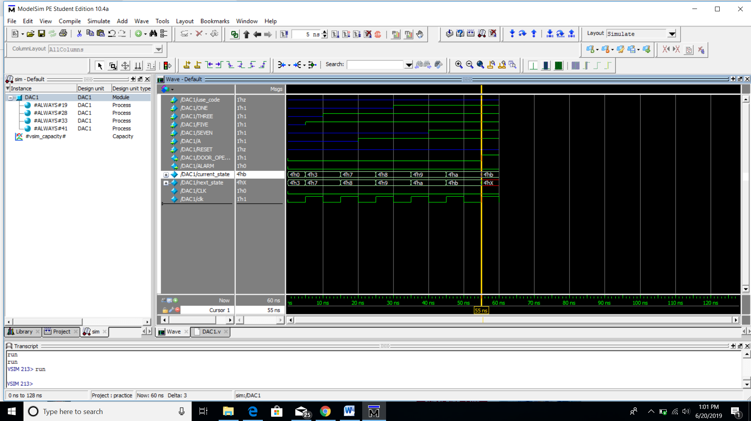

Slide 6
Notes
Kindly zoom the simulation because the clock input used is of 1 ns because of the concern of data related to day of night.
The scale used is 250 ns for 8 hours of night and 500 ns for 16 hours of day.
The run length used should also be of 1 ns.

Slide 7
CONCLUSION
We have programmed a Digital Access Control in VERILOG language.
And output is evaluated using random inputs and output appeared to be correct.

Slide 8
ACKNOWLEDGEMENT
I would like to thank my teacher Mr. Chiranjeev for guiding me towards the completion of project.

Slide 9
THANK YOU
MADE BY:- SAURAV SHARMA
COLLEGE:- GALGOTIA’S COLLEGE OF ENGINEERING AND TECHNOLOGY
YEAR:- IInd

